Slide 2
Response to Instruction and Intervention (RTI²) It is the LAW
Reviewing the Process and Increasing Fidelity of Implementation

Slide 3
RTI2 SNAPSHOT
Fall benchmark
Instructional levels
Data team meetings
Student intervention plans
Intervention logs
Records of students needing tier 2 and tier 3
Fidelity checks
Progress monitoring
Parent communication
School level training for the PCG Dashboard

Slide 4
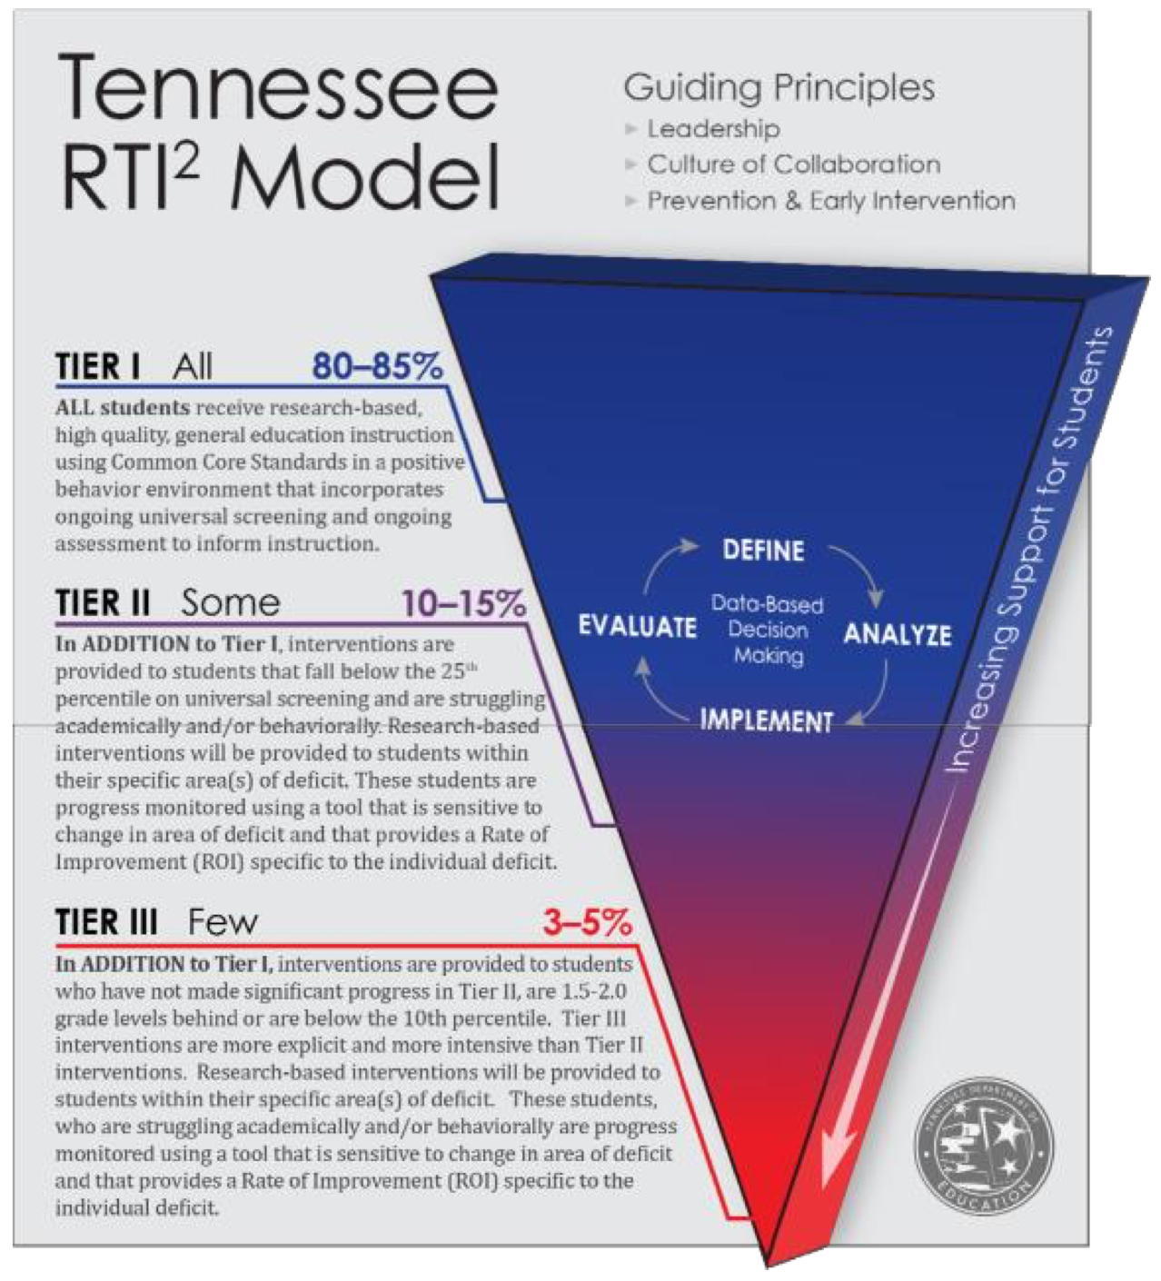

Slide 5
RTI²
RTI² is more than a checklist to be completed or data points to obtain.
RTI² is not only about collecting data, it is about analyzing data to make appropriate decisions to guide interventions.
RTI² is truly a means for ensuring that student growth and success occurs on a daily basis.
"RTI is a path to providing instructional opportunity to any student struggling to succeed, and should not be viewed as a path to special education eligibility."
Dr. Kathleen Airhart

Slide 6
Academic Standards vs. Skills
Standards-Based | Skills-Based
NWEA MAP | easyCBM
Administered 3 times per year (Fall, Winter, Spring) | Administered to students identified by SCS, based on MAP scores
Defines the knowledge students are expected to learn in a subject in each grade | Information learned relevant to student success
Provides clear path to gain proficiency | Skills build upon one another
Increases in complexity in subsequent grades | Foundational in reading, math, and writing
Defines what students need to know | Allow students to access, process, and express their knowledge
Deficit requires remediation | Deficit requires intervention and progress monitoring

Slide 7
Determining Tier 2 and Tier 3
Once MAP is complete, then each school will be given a list of students who will complete the initial benchmark assessment on easyCBM.
Following the administration of the easyCBM benchmark, data should be reviewed within one week of administration.
Students performing at or below the 24th percentile in one or more area will then receive further assessment with easyCBM to establish the instructional level for intervention and progress monitoring.
Tier 2: 10th – 24th percentile
Tier 3: 0 – 9th percentile
*

Slide 8
Instructional Levels
Determines a student’s most basic skill area deficit
Indicates the grade level of intervention that a student needs
Necessary for setting appropriate goals for individual students
Needed in order to monitor a student’s progress and calculate rate of improvement appropriately

Slide 9
Tier I Instruction
Reading Tier I (Integrated Language Arts)
K-2 150 minutes ( 90 min must be uninterrupted)
3-5 120- 150 minutes
6-12 55 minutes
Math Tier I
K-1 60 minutes
2 75 minutes
3-5 90 minutes
6-12 55 minutes
Notes:
Exception: Elementary students in Clue may be pulled from Tier 1.
In high school, students should not be pulled from a credit bearing course required for graduation.

Slide 10
Interventions
30 minutes a day for Tier 2
45 minutes a day for Tier 3
No student may be pulled from Tier 1 (core) instruction to receive RTI2 interventions or instructional resource
The essential part of RTI is small group face to face instruction
District-approved computer based interventions should only be completed during scheduled intervention time

Slide 11
Interventions
Students must receive research based interventions in teacher led small groups every week
Teacher led sessions must have appropriate small group ratios based on the intensity of interventions
Tier 2: K-5 1:5; 6-8 1:6; 9-12 1:12
Tier 3: K-5 1:3; 6-8 1:6; 9-12 1:12
Computer based intervention programs may also be used to supplement small group interventions
Notes:
For SCS: Interventions include: Achieve3000, and i-Ready.

Slide 12
Interventions
Intervention plans that comprise of both small group lessons AND computer based programs must contain a required number of minutes of small group lessons to maintain fidelity
Tier 2: minimum
60 minutes/week teacher-led small group*
90 minutes/week computer
Tier 3: minimum
135 minutes/week teacher-led small group*
90 minutes/week computer
*Scripted small-group skills based lessons are available in
i-Ready and Achieve 3000 in the teacher resources section.
30 min. / day
2 days / week
3 days / week
45 min. / day
3 days / week
2 days / week
Notes:
In high school, the intervention teacher must be endorsed in a high school subject area (any).
In elementary and middle school, the interventionist needs to be either teacher-led or under the direction of the teacher (highly trained).

Slide 13
Interventions
Only one skill deficit is targeted at a time as documented on student’s RTI² Intervention Plan and Intervention Logs
Changing an intervention or targeted skill area outside of RTI² Data Team Meeting will invalidate the data for that intervention period
Changes in instructional level and skill deficit area must follow specific data guidelines outlined in the District Implementation Guide

Slide 14
Progress Monitoring (PM)
PM data is collected using easyCBM only
PM data is collected at instructional level
PM data is collected in targeted skill deficit area only
PM data is collected weekly for Tier 3 and students with disabilities
PM data is collected every other week for Tier 2
Notes:
High School training for easyCBM will be provided.
While easyCBM provides suggestions in the areas and frequency of progress monitoring, in SCS we follow TDOE RTI2 requirements.

Slide 15
RTI² Data Teams
Coordinated by principal-appointed, school-based RTI² Chairperson
Collective group of professionals in school building
Hold meetings every 23 instructional days
Review RTI² data for each student to make adjustments to Student Intervention Plans to ensure all students make adequate progress
Principals should submit names of core RTI² Data Team by August 5, 2017 to Jasmin Jackson, jacksonj3@scsk12.org
Notes:
Adequate progress is based on the student’s calculated Rate of Improvement (i.e., how well the Student Intervention Plan is working)
Pass out 2016-17 Core School-Based RTI² Data Team form. It will also be distributed electronically.

Slide 16
RTI² Data Teams
Notes:
Adequate progress is based on the student’s calculated Rate of Improvement (i.e., how well the Student Intervention Plan is working)
Pass out 2016-17 Core School-Based RTI² Data Team form. It will also be distributed electronically.

Slide 17
Fidelity Checks
Occur during tiered interventions
Completed for each student in Tier 2 or Tier 3
Tier 2: fidelity should be checked at least 3 times for every 8-10 progress monitoring data points
Tier 3: fidelity should be checked at least 5 times for every 8-10 progress monitoring data points
Completed by trained team of school- based staff
All Fidelity Checks must be completed on SCS required forms, and copies are to be placed in each student’s RTI² file
Notes:
All SCS RTI2 forms may be found in the 2016-17 District Implementation Guide

Slide 18
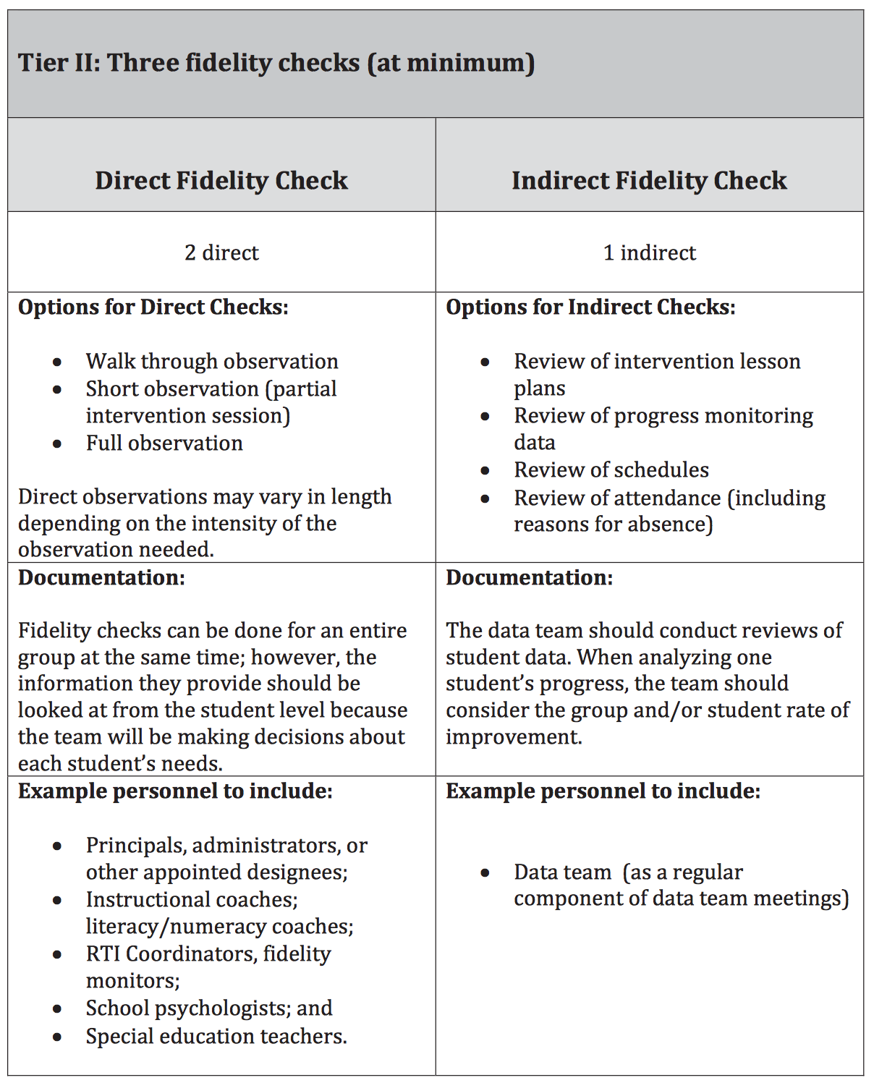
Notes:
All SCS RTI2 forms may be found in the 2016-17 District Implementation Guide

Slide 19
Parent Notifications
It is required that parents be informed using the appropriate SCS letter
When their child is identified for tiered interventions
When there is a change in intervention
After every RTI² Data Team Meeting to describe their child’s progress in the RTI² framework
All parent letters must be documented in student’s file either by placing a copy of the letter in the file or by making a notation in the Parent Contact Log
Notes:
All SCS forms are found in the 2016-17 District Implementation Guide

Slide 20
Scheduling for English Learners
ESL certificated or an ESL endorsed teacher must provide direct services one (1) to two (2) hours per day for pre-functional, beginning, and intermediate EL​
WIDA level 1.0 to 3.5 on composite AND literacy. ​
Students at the more advanced levels (WIDA level 3.6 to 5.0 on composite and literacy) may have programs more tailored to their needs including, but not limited to: ​
fewer hours of ESL direct instruction, ​
push-in service in which the ESL teacher works inside the regular classroom with ELs for subjects for which they are most proficient. ​
skills based interventions​
ELs should continue to receive up to one (1) hour of direct service each day until they achieve English proficiency that allows transition to regular academic programs to take place for content areas of instruction.

Slide 21
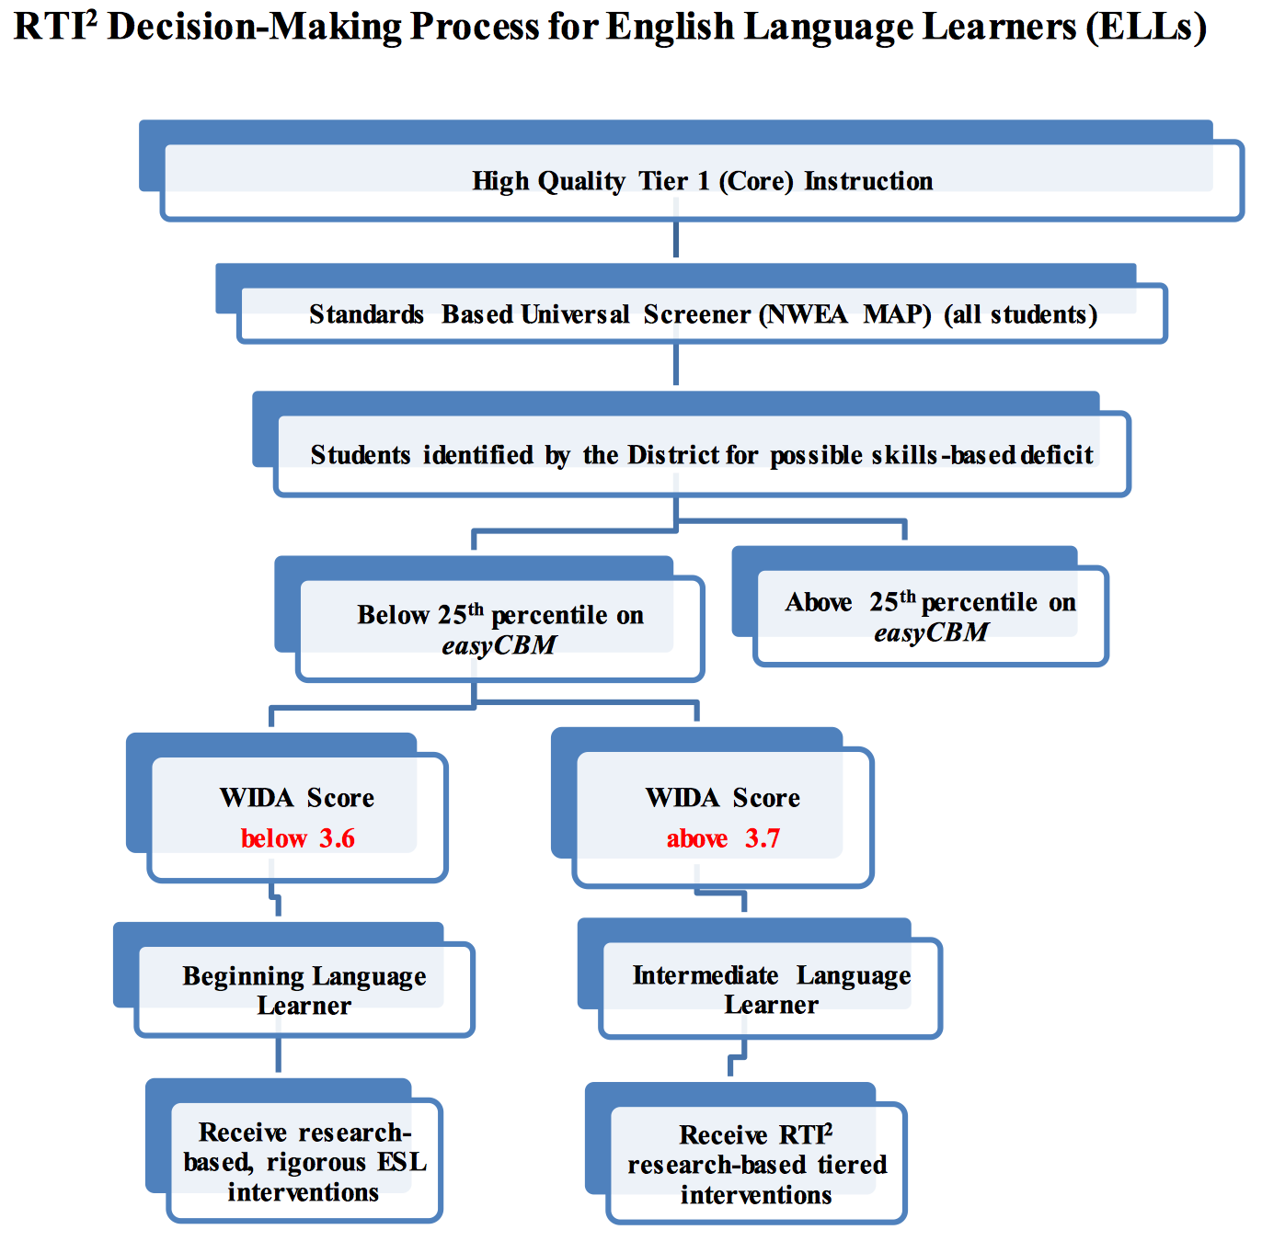

Slide 22
Transitional Students (T1-T4)
Transitional EL students are considered proficient and may be mainstreamed in the regular classroom with careful monitoring for two (2) years. Should a transitional student begin to have difficulty in classes, he or she should receive meaningful ESL support immediately.​
If this support is not successful, the district must have a procedure in place to reclassify the student as an EL.

Slide 23
RTI2 Process and Special Education
The principal and/or designee monitors the implementation of RTI2. This should not be a SPED teacher or school counselor.
School psychologists review data collected in compliance with the RTI2 process to ensure that state criteria are met for consideration of referral for identification of students with Specific Learning Disabilities. School Psychologists are members of the data team and consult with schools regarding compliance in implementation of the RTI2 process.
Failure to identify students with special needs is violation of IDEA and federal protections.

Slide 24
Current SPED Students and Recertification
Re-evaluations and Data Points
Ensure current SPED students with a Specific Learning Disability who need to be re-evaluated for the 2017-18 school year have data points and IEP team meetings.
If re-evaluations are not completed, we are still required to serve these students, but the District does not receive funding for them.

Slide 25
Resources
2017-2018
Updated RTI² District Implementation Guide and Principal One Pager Coming Soon!
District One Pager
TDOE RTI² Manual

